Slide 1
Diamond Industry Services Management

Slide 2



B & B INSTITUTE OF TECHNOLOGY
V.V.NAGAR
DIAMOND INDUSTRY SERVICE MANANGEMENT
PROJECT-1 (3351605)
Guided by,
Prof. Drashti R. Raval
IT Department,
BBIT ,V.V.Nagar
Prepare By:
Jiwans Oza (206040316019)
Kunj Virani (206040316015)
Jeel Patel. (206040316031)

Slide 3
OUTLINE
Introduction
Existing system
Project objective
Scope of the work
Tools and Technologies
Er Diagram
Use Case Diagram
Data Flow Diagram

Slide 4
OUTLINE Contd.
Home Page
Login Page
Registration page
Database Table
Product Page
Product 1Detail
Product 1 checkout

Slide 5
OUTLINE Contd.
Service Page
Regular Maintenance
Machine Breakdown
Skilled Worker
Admin Panel
Reference

Slide 6
Introduction
Dimond industry service centre might be very less. Unfortunately, the older version of this system used manual guideline which can lead to unsorted task for repairs.
Staff also will not have enough hands to handle many customers at the same time. Thus, with the existing of industrial Service System Using Priority Scheduling, Dimond Industry service centre management can be managed easily.

Slide 7
Introduction cont.
The objectives of this system are to design and develop a new system which can help to manage task in more organize with Priority Scheduling technique.
This way, the task can be handling according to priority of booking time. It is also to implement a system where the staffs who handle the repair task and distribute the task accordingly.
The system will assign the repair task to the staff that did the least job for the day. This system will use Priority Scheduling technique which is use to distribute job task and job schedule. In conclusion, the system will be able to help the company to manage repairs and staffs compared to the older system which is use manual guideline

Slide 8
INTRODUCTION
In our system, we help Dimond Industry to grow their business without any problem.
We help him in to find the skilled workers, provides a services for repairing persons for machine breakdown, all spare parts library for there working machine required and different modals of Dimond related machine guideline catalogs.
We help him which fast solution of any problem related to Dimond industry.
We help him to get people for this industry by registration details.
We gave him content facility to buy any machine with Owner directly communication.
We provide all facilities in a one single click system.
Also desk for expert guide to buy Dimond machine.

Slide 9
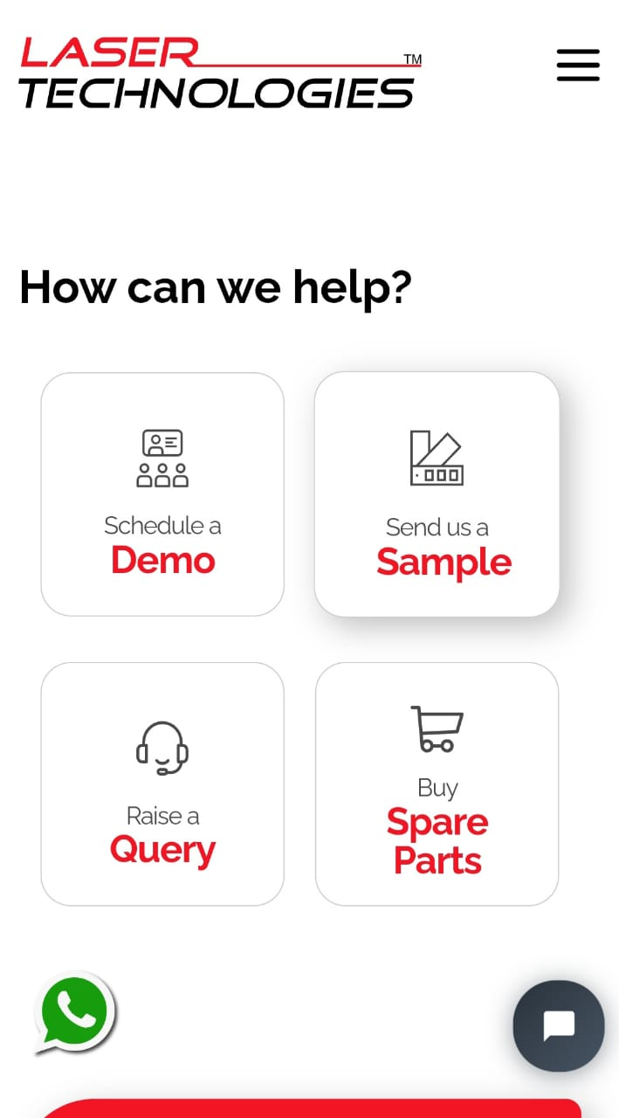
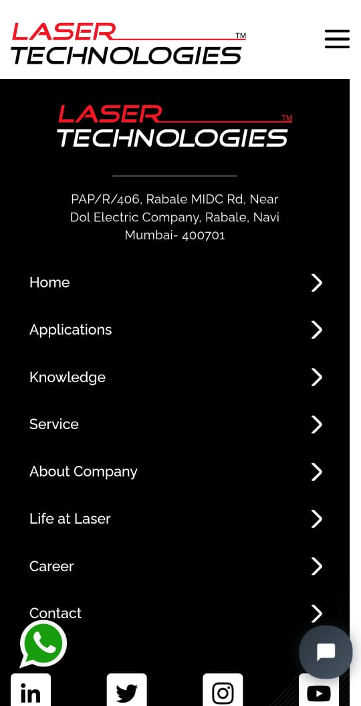
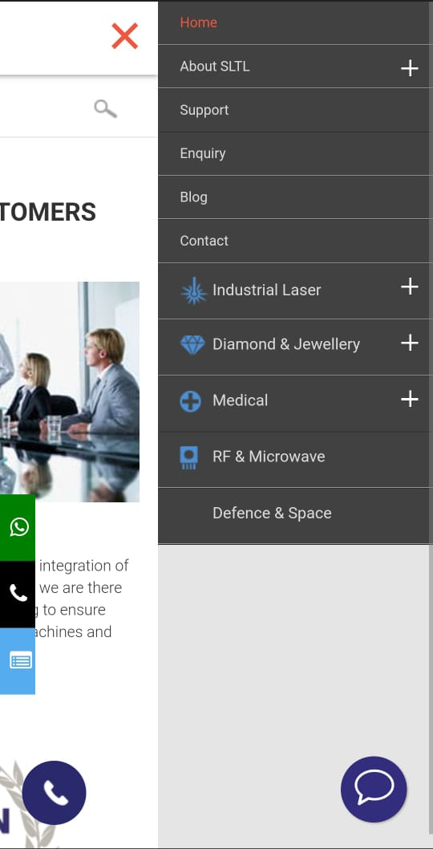
Existing System

Slide 10
Project Objective
We want to develop a website and also learn how to develop the website's logic.
We Provide Employment to Skilled Workers
Provides a services for repairing persons for machine breakdown
We Provide fast solution of any problem related to Dimond industry.
We provide all facilities in a one single click system.
To reduce Communication gap between sellers & customers.
This is Very fast interaction media between sellers & customers.
Also this is easiest way you can save more time

Slide 11
Scope of the Work
We want to develop a website and also learn how to develop the website's logic.
To reduce Communication gap between sellers & customers.
This is Very fast interaction media between sellers & customers.
Also this is easiest way you can save more time.
To Provide Employment to Skilled Workers who are unemployed.
Very less time consuming and reliable website for purchase Machine

Slide 12
Tools And Technology
H/W requirement:-
RAM: 256 MB
Processor: Minimum 1 GHz.
S/W requirement:-
Operating system: Windows 7 or Windows 10
Front end: Visual Studio 2019 Community.
Back end: MYSQL.
Language: HTML, CSS, Bootstrap, PHP

Slide 13
Users of Project
Admin
Service Men
Industry

Slide 14
Scope Of the Work
In this Industry will takes services on breakdown of machines and maintenance
In this Service men will provide service related to machines.
In this we will share machine Guidance to customer
We also provide modification in the machine
We will provide employment to skilled workers

Slide 15
How Project is Helpful To Society ?
Most useful For Industry
Very less time consuming and reliable website for purchase Machine
We Provide Employment to Skilled Workers

Slide 16
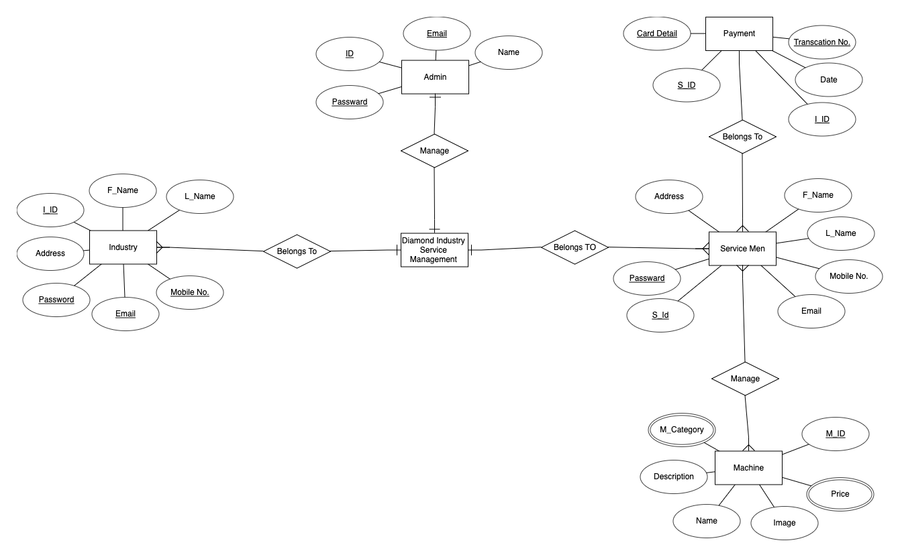
ER Diagram

Slide 17
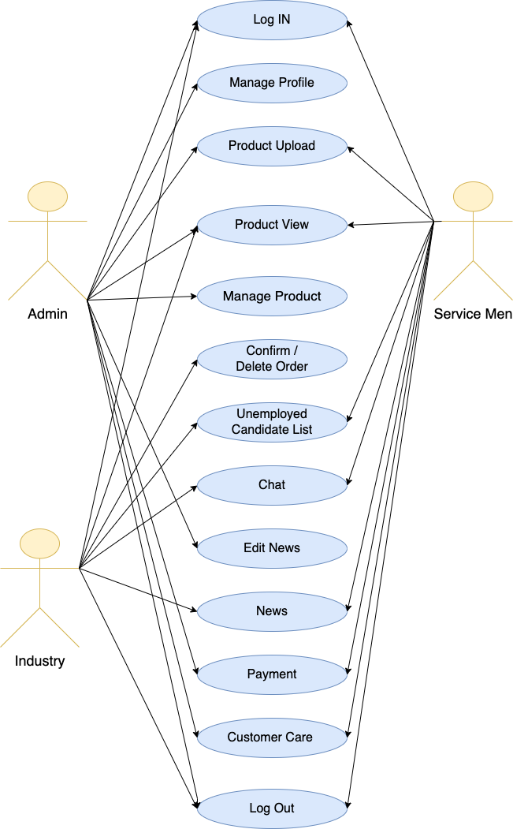
Use Case Diagram

Slide 18
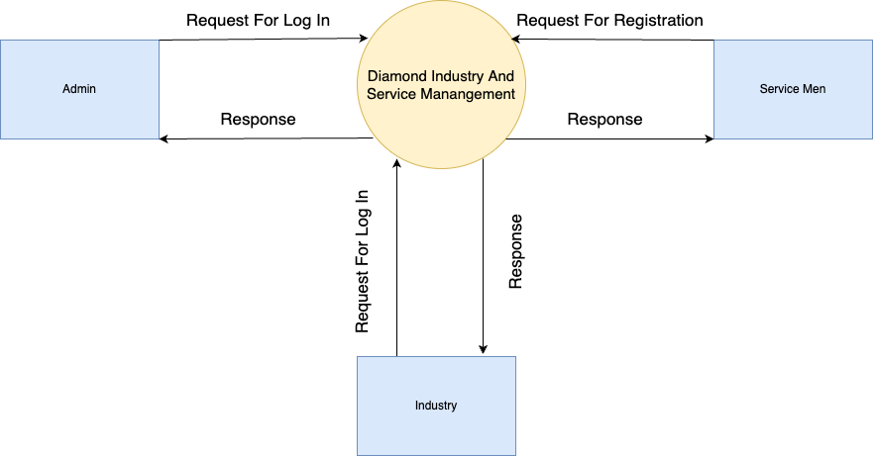
Data Flow Diagram. (Level 0)

Slide 19
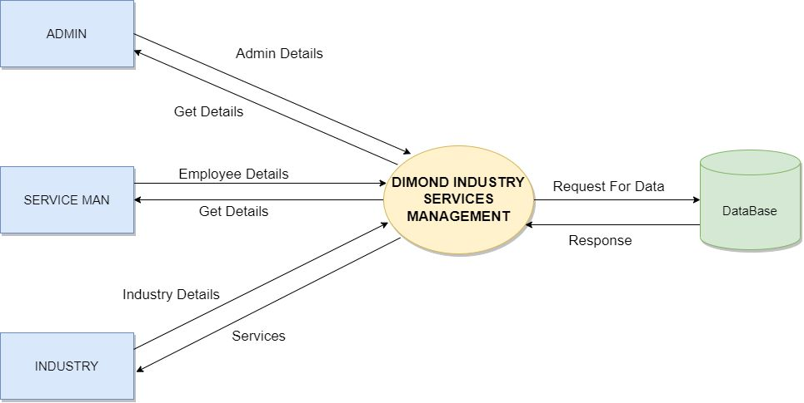
Data Flow Diagram. (Level 1)

Slide 20
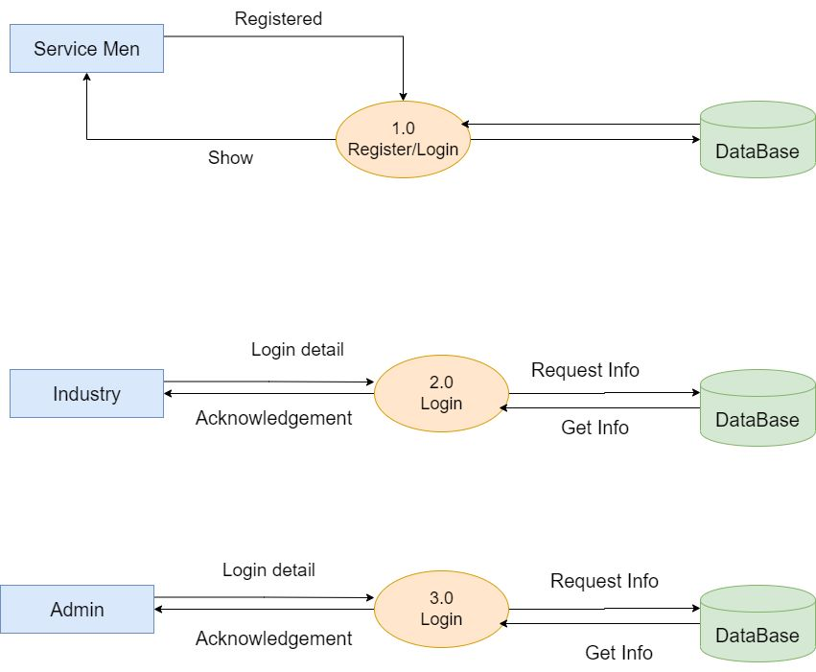
Data Flow Diagram. (Level 2)

Slide 21
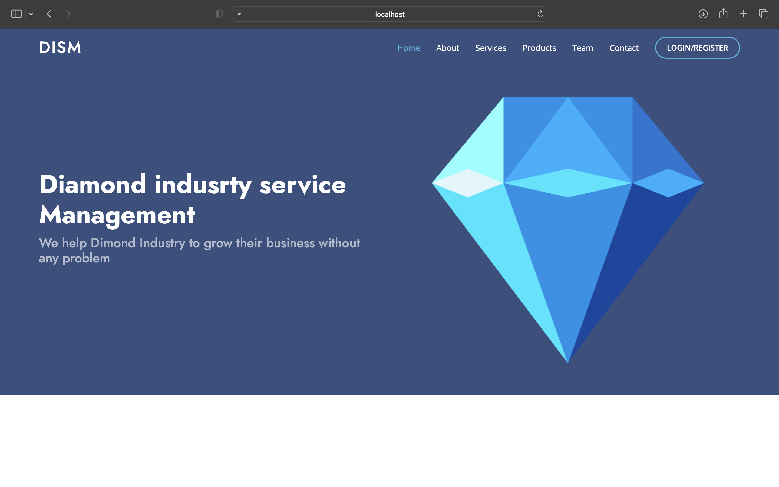
Home Page

Slide 22
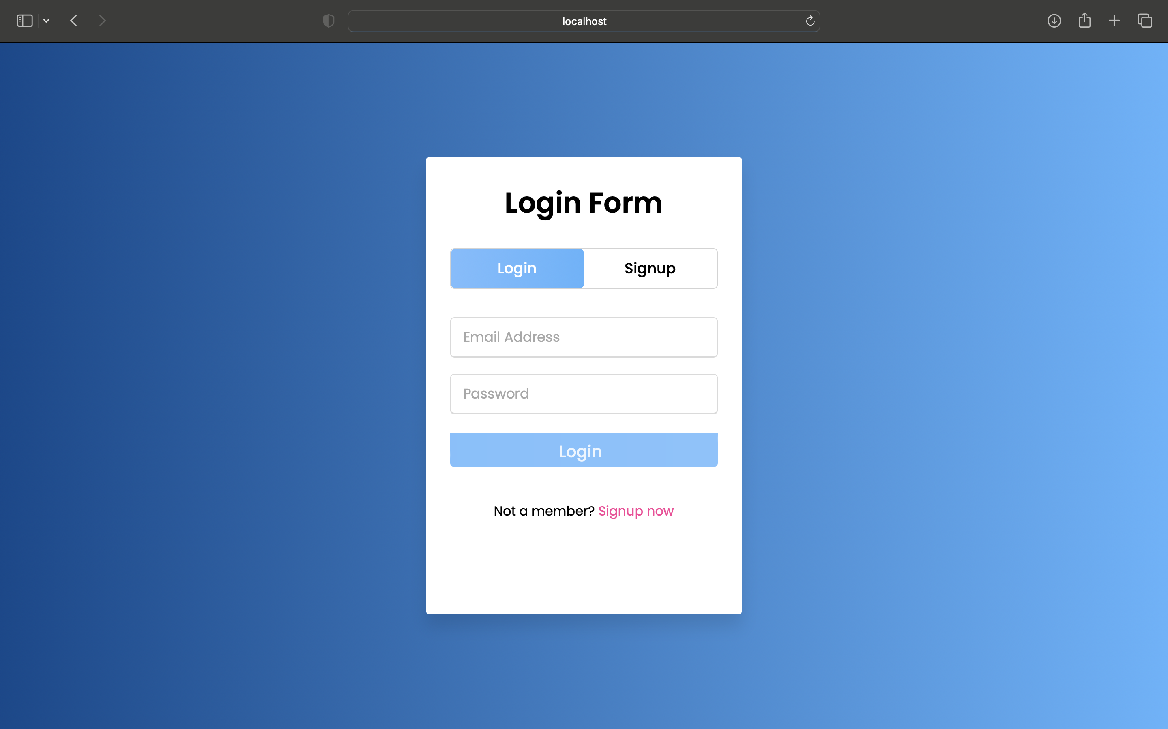
Login Page

Slide 23
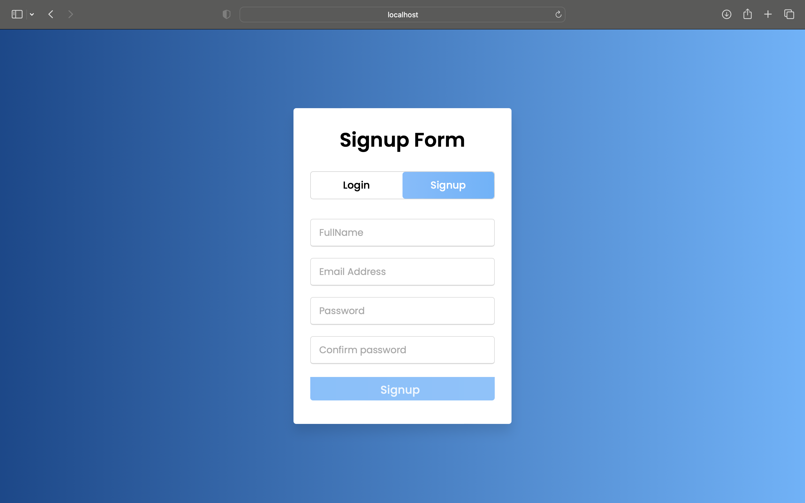
Registration Page

Slide 24
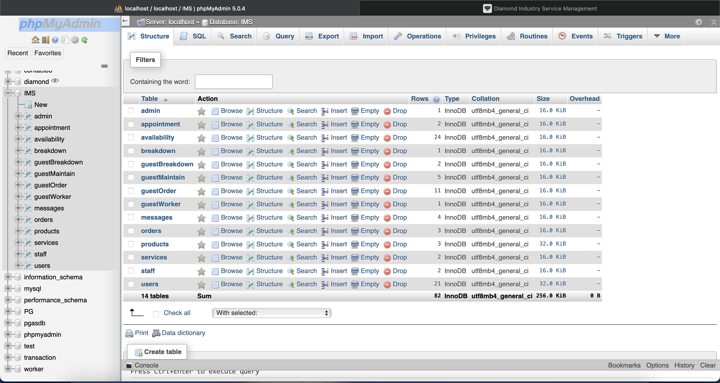
Database Table

Slide 25
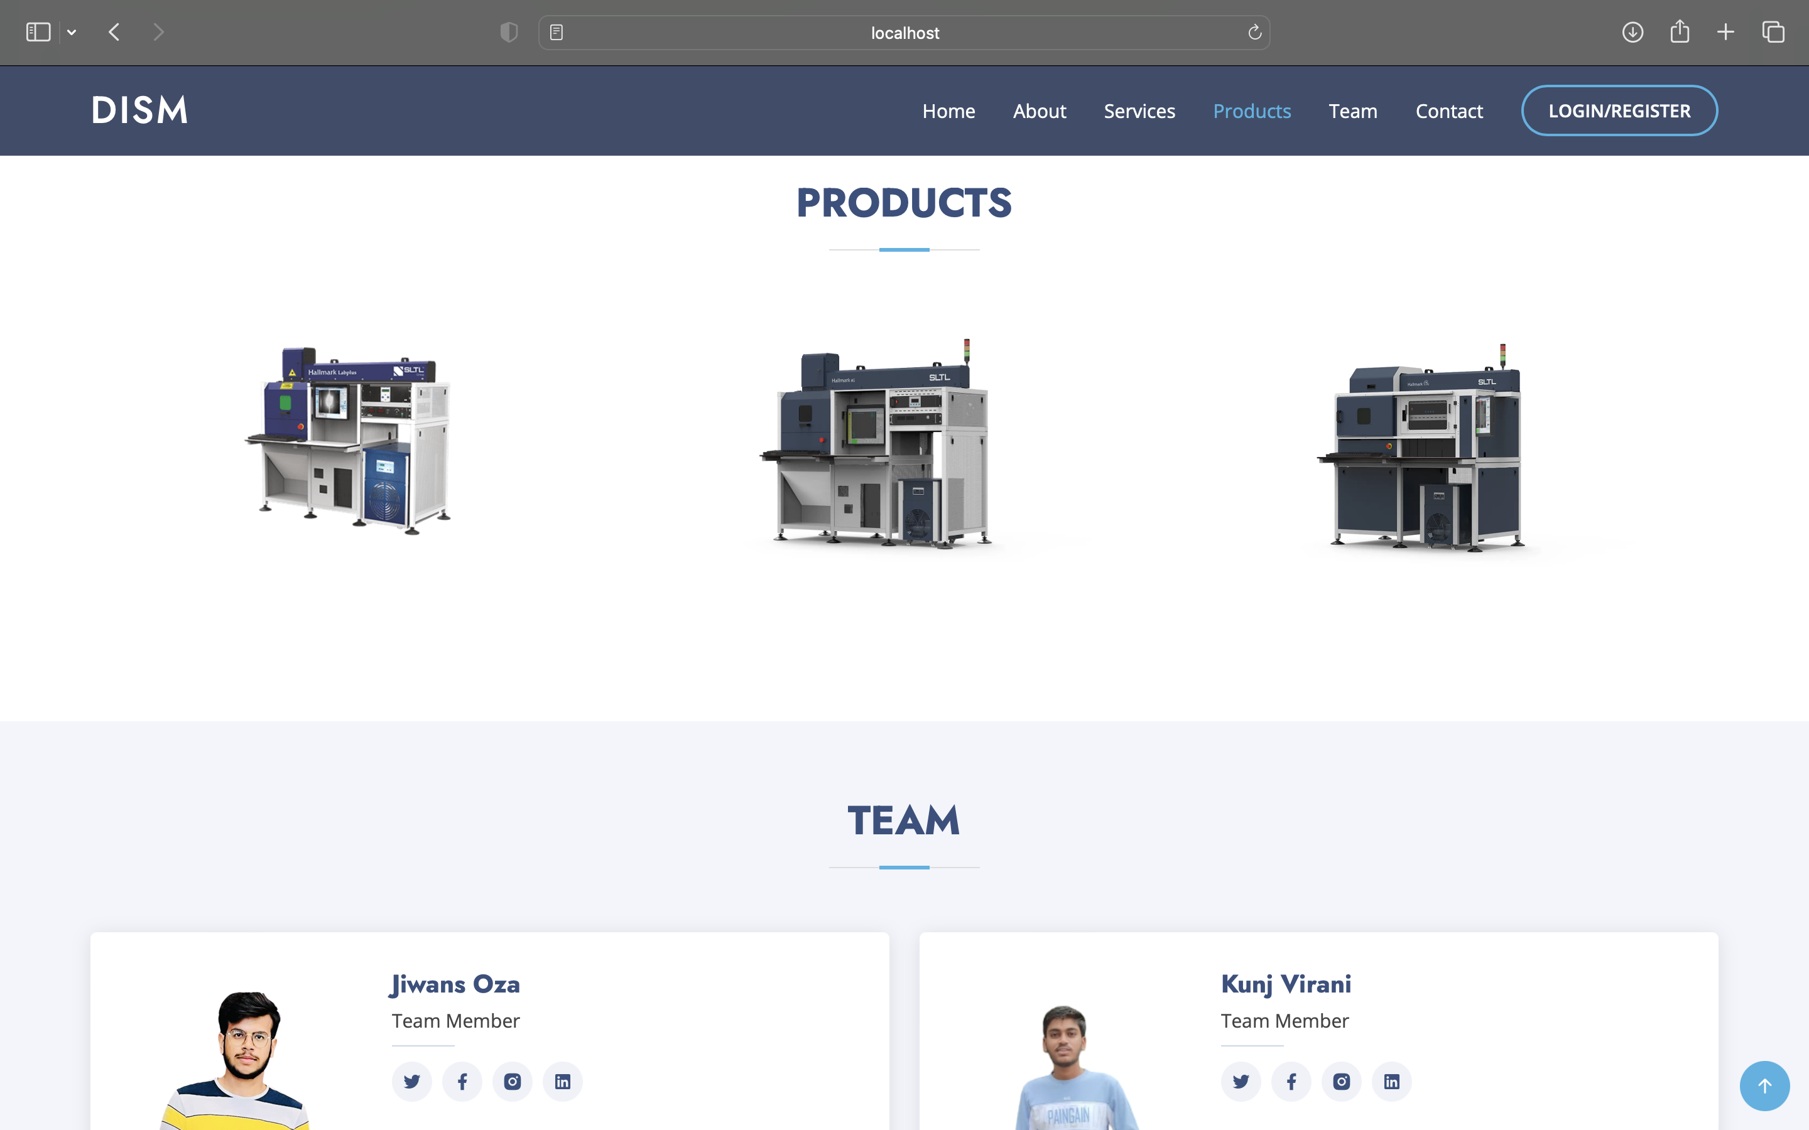
Products Page

Slide 26
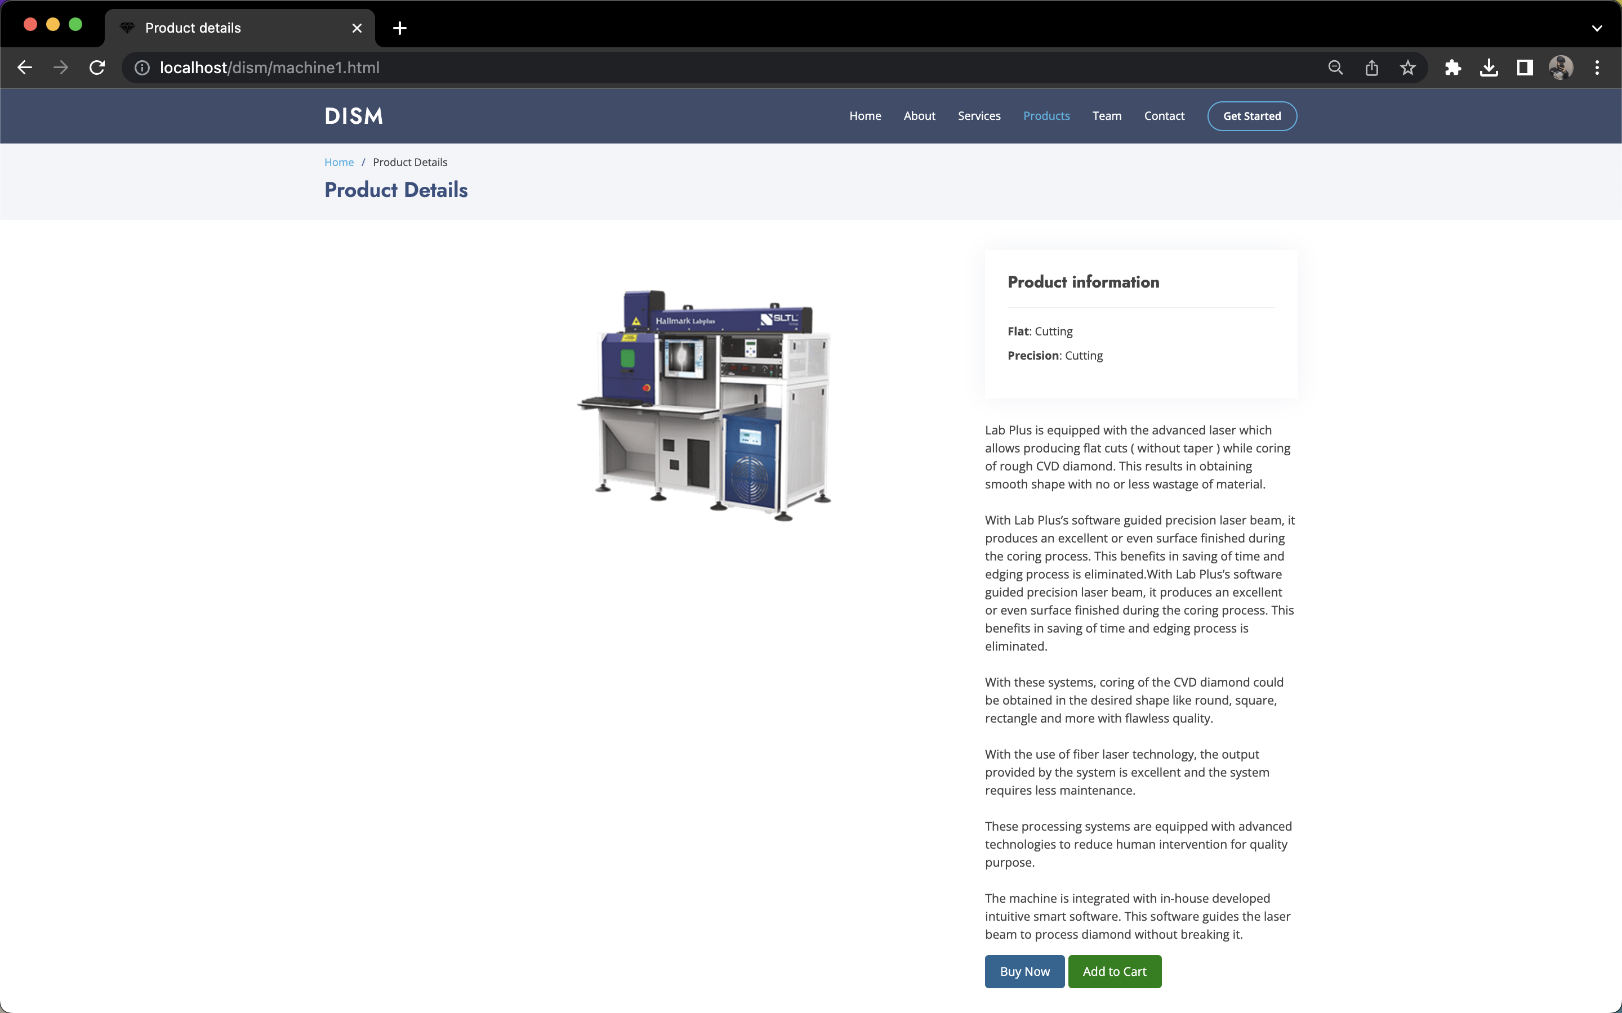
Product 1 Details Page

Slide 27
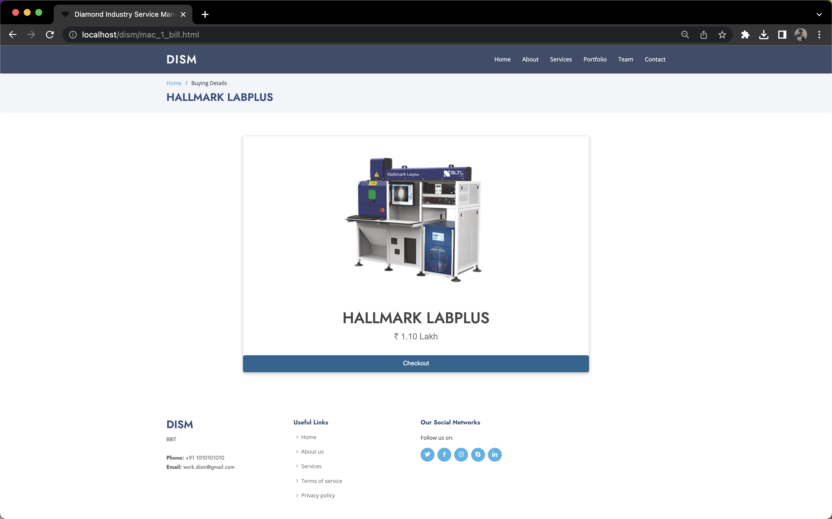
Product 1 Checkout Page

Slide 28
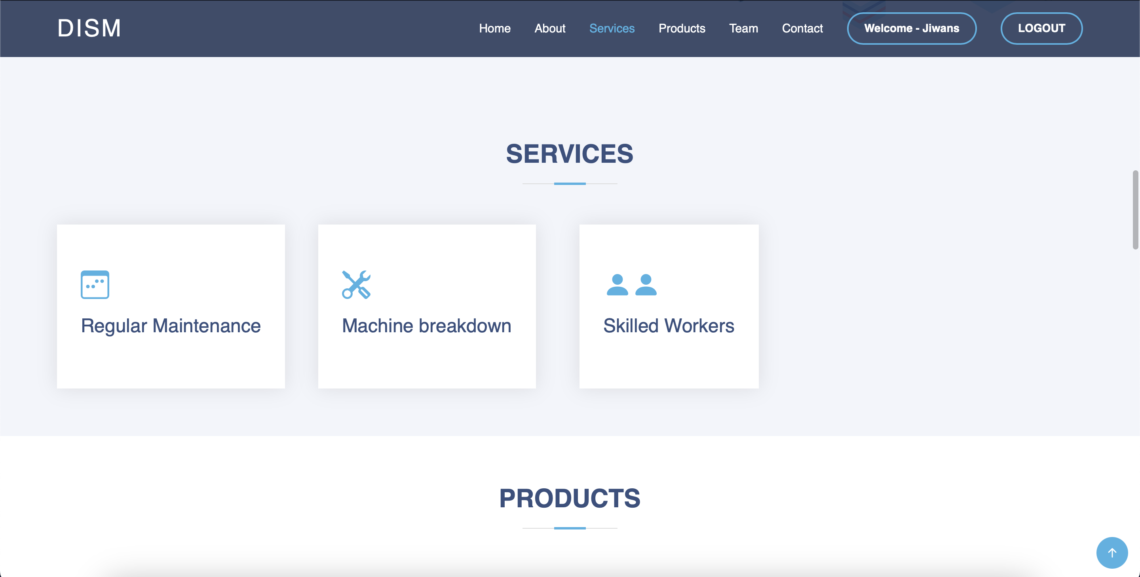
Service Page

Slide 29
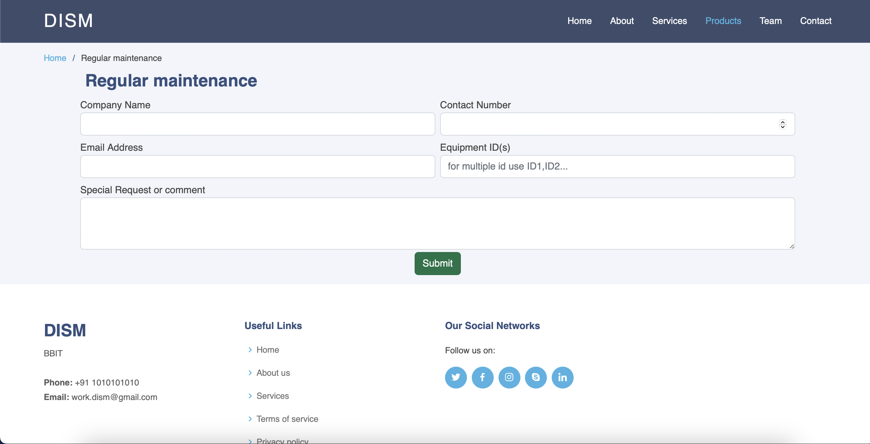
Regular Maintenance

Slide 30

Machine Breakdown

Slide 31
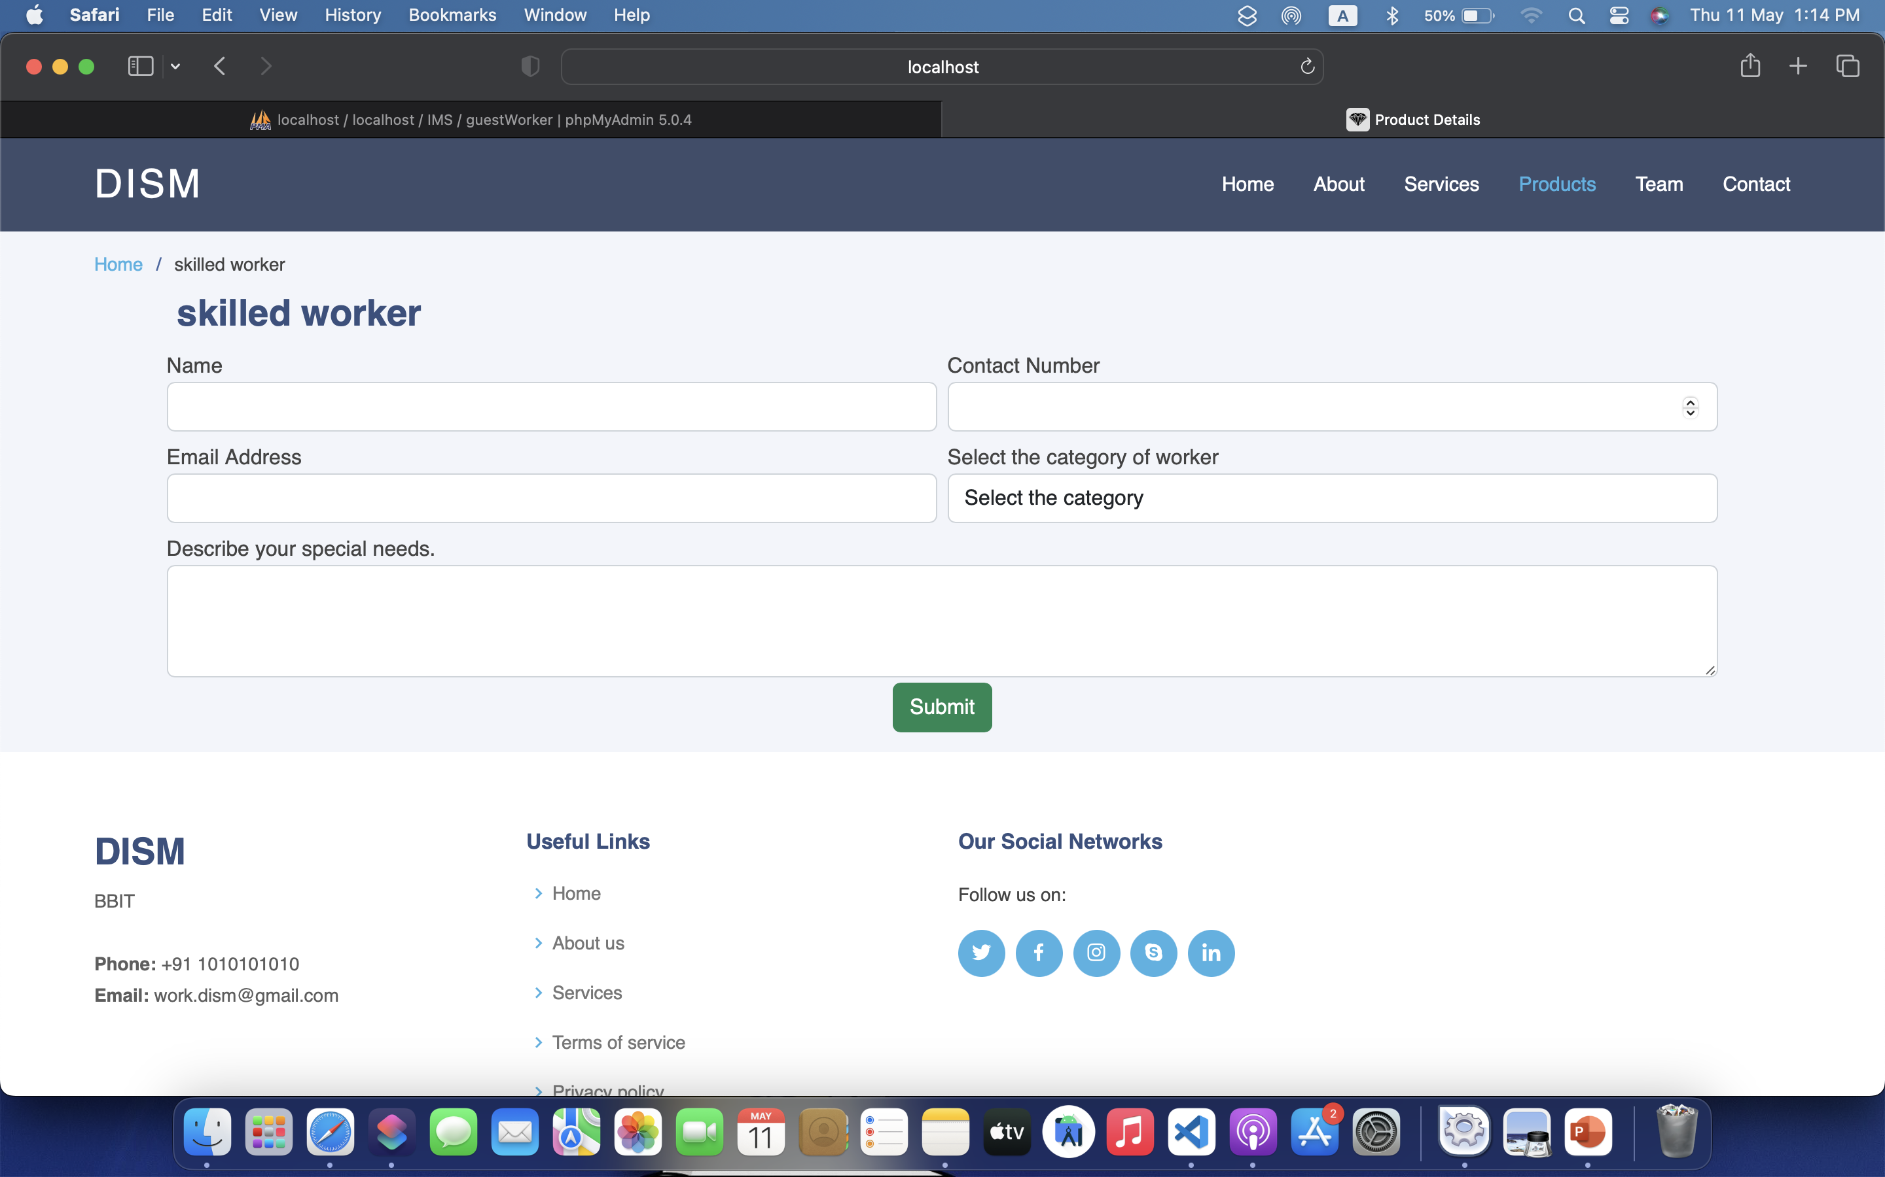
Skilled Worker

Slide 32
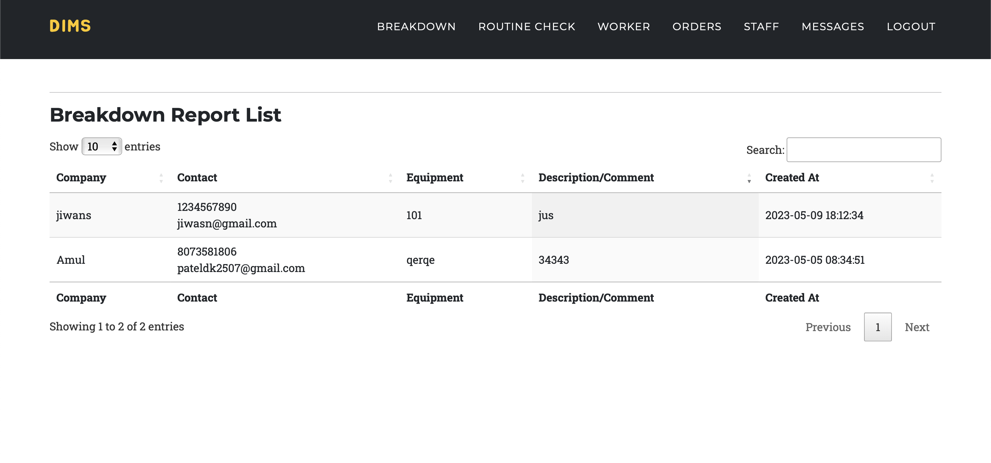
Admin Panel

Slide 33
Advantages
We Provide Employment to Skilled Workers
Provides a services for repairing persons for machine breakdown
We Provide fast solution of any problem related to Dimond industry.
We provide all facilities in a one single click system.

Slide 34
References

Slide 35
Reference
https://www.sltl.com
https://www.lasertechnologies.co.in
https://www.mtechlasersolution.com/
https://draw.io
https://erdplus.com/

Slide 36
Thank You ☺

